Slide 1
Linear and Locally Weighted Regression
Prasad Nair
Katayoun Neshatpour
Kalhan Vundela

Slide 2
Outline :
Introduction
Regression types
Linear
Locally weighted
Logistic
Applications
Case Studies and Demo Screenshots
Conclusion

Slide 3
Introduction
Regression is a process for estimating the relationship among variables.
It is important to note that Correlation is not Causation.
E.g. Nations with more TV set have higher life expectancy
E.g. variable A is how much grass grows per week, and variable B is the average depth of the local reservoir.
Notes:
While we talk about the relationship it is important to note the differences between causation and correlation. Just because to variable are correlated does not mean that they are caused by each other. They could both be caused by a third parameter.
As an examples think of the hypothesis that says “Nation with more TV sets have higher life expectancy.” . While these two variables are correlated they to not have a casual relationship. I.e. having more number of TV
Sets does not cause higher life expectancy.
As another example, suppose variable A is the grass growth per week and B is the average depth of the local reservoir. While they are both correlated, they are both be caused by a third variable, i.e., the amount of rain. Thus while they have correlation relationship they do not have causation relationship.

Slide 4
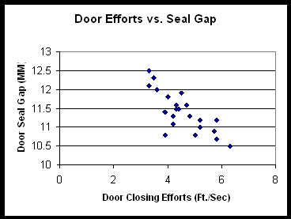
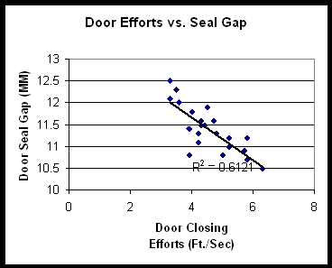
Correlation and Regression analysis
https://www.moresteam.com/toolbox/regression-analysis.cfm
Notes:
About the difference between correlation and Regression:
A statistical measurement of the correlation can be done by calculating the covariance or the correlation coefficient, which ranges between -1 to 1. With 1 showing perfect correlation, when one variable increases the other increase too. -1 shows perfect negative correlation, when one variable increases the other decreases. 0 shows no correlation between two variables.
An example to show the difference: A study done by the improvement team of an Automobile company that studies the door closing effort with respect to the door seal gap. By door seal gap we mean the width of the gap between the sealing fledge of the car door and the sealing fledge of the car body (how tight the door is set to the body.). It is illustrated in the Y-axis and X-axis shows the door closing effort.
To do the correlation analysis first we have to do draw the scatter diagram. The figure shows that there is a negative correlation between the door closing effort and the door seal gap.
While correlation assumes no casual relationship between the variables, regression assumes one variable is dependent on another independent variable. This is the other figure the regression assumes the door seal gap is the cause of variability in the door closing effort. Thus regression calculate model that estimate the door closing effort based on the door seal gap. A straight line is used in this figure for modeling other kinds of functions may also be utilized.

Slide 5
Simple and Multiple Regression analysis
Simple Regression Analysis a regression analysis in which one variable is dependent upon another single independent variable.
Multiple Regression Analysis uses a similar methodology as Simple Regression, but includes more than one independent variable.
e.g. Housing price
https://www.moresteam.com/toolbox/regression-analysis.cfm
Notes:
Regression can be divided into two categories.
Simple Regression Analysis is a regression analysis in which one variable is dependent upon another single independent variable. In the previous example we assumed that the door closing effort is dependent on only door seal gap. However there is also the multiple regression analysis in which more than one independent variable is studied. For example in the previous example the improvement team figured out that the door weather-strip durometer softness also influences the door closing effort. Thus a multiple regression analysis can be done to derive model of the door closing effort based on bot the door seal gap and the weather-strip durometer softness. Another advantage of the multiple regression analysis is that it shows which parameter has a more considerable effect on the dependent parameter which in this examples was the door seal gap.
Multiple Regression can be useful for modeling many situations. For instance for housing prices which are dependent on many variables including nr of rooms, crime rates, etc.

Slide 6
Regression Types
Linear regression
Locally Weighted
Logistic regression
Ridge regression
Lasso regression
Notes:
We introduce different types of regression that we are going to introduce linear and locally weighted regression and logistic regression. And we will talk briefly about the Ridge and Lasso regression.

Slide 7
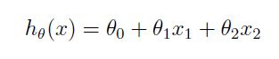
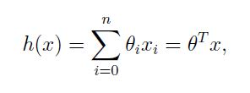
Linear Regression
Linear Regression is one of the regression algorithm to predict the output values given some input values.
Formally, it is relation between scalar dependent variable y and independent variable x.
How do we choose the parameter, so that hypothesis h makes the actual predictions?
Notes:
If we take X1 and x2 are features of the data, then we write hypothesis h(x) as above equation. Ѳ’s are called parameters of learning algorithm. Ѳ₁, Ѳ_{2…} are all real numbers. The job of learning algorithm is to use the training set and learn or predict appropriate parameters( here Ѳ). The parameters can be any equation or value. The learning algorithm tries the choose the parameter to be minimum value. If we take x and Ѳ as parameters we can convert the equation to second one. The n is the number of features for the problem.
So now how can we choose the parameter, so that hypothesis h makes the actual predictions ?
Solution is to minimize the cost function .

Slide 8
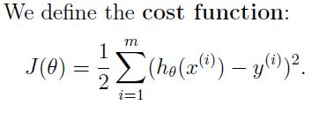
Algorithms for Linear Regression
Gradient Descent / Batch Gradient Descent
Stochastic Gradient Descent
Matrix Derivatives
Notes:
One solution to predict/choose parameter is to make H(x) as close as possible to y, Where H(x) is the predicted value and y is the actual value. We call it cost function. The m is number of instances and we use ½ to minimize the calculations before. The value for the cost function can be found by using any of these three methods. They are Gradient Descent / Batch Gradient Descent , Stochastic Gradient Descent and Matrix Derivatives.

Slide 9
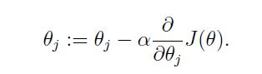
Gradient Descent
Algorithm :
Start :
1. Assign value Ѳ = 0 (vector).
2. Keep changing Ѳ to reduce J(Ѳ).
3. Repeat till we get minimum J(Ѳ).
End.
We perform the update of Ѳ repeatedly by equation
Notes:
Gradient Descent : This is the basic algorithm where we take some value to parameter. Here we take Ѳ = 0 where 0 is a vector. We keep changing the Ѳ to reduce J(Ѳ) until we end up in minimum J with respect to Ѳ.

Slide 10
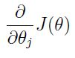
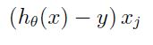
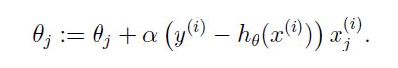
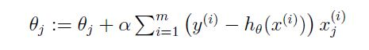
If we update the value Ѳ with the partial derivative of J with respect to Ѳ.
We get the equation :
is
If we do that for m values, where m is number of instances, we get the equation as below
Notes:
If we update the value Ѳ with the partial derivative of J with respect to Ѳ. We get the second equation stated above. As we are calculating for m instances, if we do the gradient descent for m instances we end up with the equation stated below. The pictorial presentation can be shown how the cost function is going to change step by step.

Slide 11
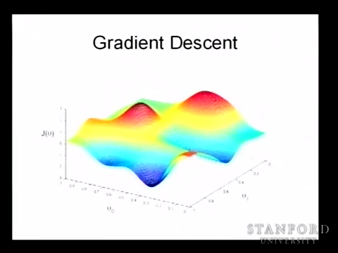



Notes:
Here you can see the pictorial presentation of the gradient descent, where y axis is the cost function J(Ѳ) and x axis are the values Ѳ1 Ѳ2. Lets take a point here, and see where can we step to make our value less than present value. If you continue stepping then you will end up with the least value. The series of steps can be seen here.

Slide 12

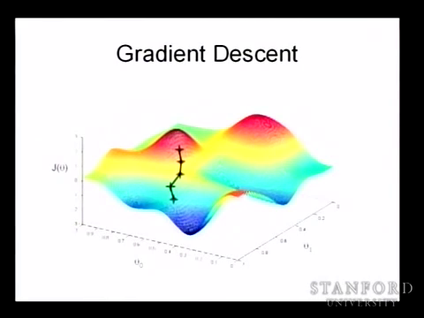

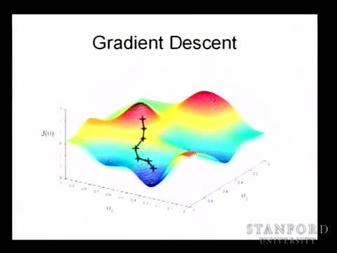
Notes:
This is the continue of steps we took to get least value.

Slide 13

What if the first step is different ?
Does it leads to same least point ?
Reference for diagrams and equations : Lecture video by Andrew Ng
Notes:
Here you end up in the least point. As you see are there any other least values, is this the least value? Why don’t we step other way? Does that leads to different value?
Lets discuss.

Slide 14





Slide 15



You end up in the point which is different
From the minimum value.

Slide 16
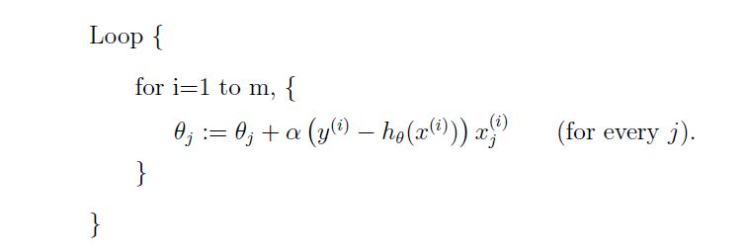
Stochastic Gradient Descent
It is also called as incremental gradient descent.
For datasets with large values this algorithm give better results and it executes fast
Notes:
For the gradient descent, on every step we are going to look at the entire data set. It turns out to be very good algorithm, but when we have many data sets, for example one million, we have to perform the sum from one to m values for every step of gradient descent. In stochastic gradient descent we perform the one step of update with one instance and second update with second instance..which leads to finish the update in very less time when compared with other batch gradient descent.

Slide 17
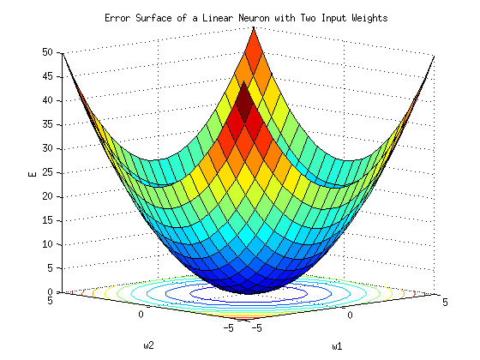
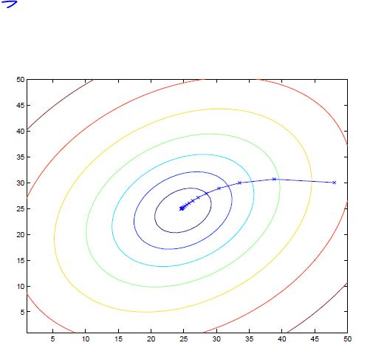
This image is not clear enough.
Notes:
As you can see, stochastic gradient descent will leads you to a graph only with one lease value. So no matter you step in different direction you will end up in same position.

Slide 18
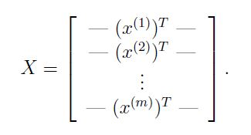
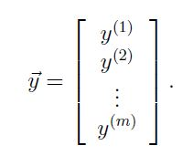
Matrix Derivatives
We find the value of Ѳ such that it minimizes the J(Ѳ).
We write J as matrix- vectorial representation
We assume the value of J(Ѳ) as 0
Notes:
In the previous two algorithms we try to minimize the value of J(Ѳ), but in Matrix Derivatives we try to find the value of Ѳ for which the value of J(Ѳ) is minimum. Here we represent the values of input set and output as matrices and which leads the J(Ѳ) as a matrix . We assume the value of J(Ѳ) as 0, in order to minimize the J(Ѳ) with respect to Ѳ.

Slide 19
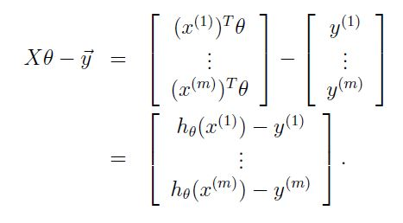
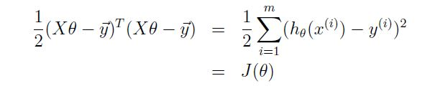
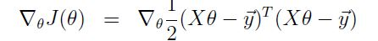
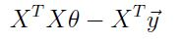
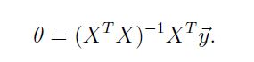

Slide 20
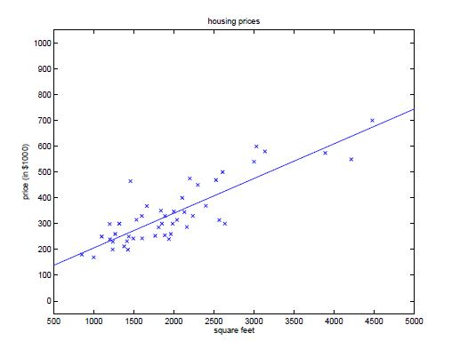
Notes:
After repeating steps of gradient descent several times, you will end up with a straight line as above.

Slide 21
Problems with Linear Regression
It tries to fit a constant line to data once the model was created. When the data fallows linear pattern and does not have much noise then the algorithm works fine.
When the data set is non linear, then the linear regression tends to underfit the training data set.
What is underfitting?
How to overcome it ?

Slide 22
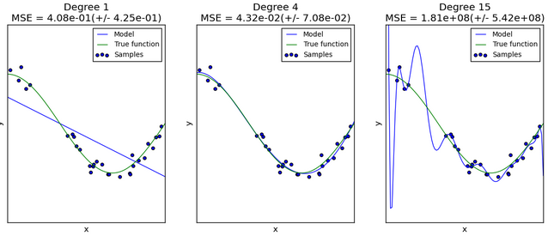
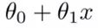
Underfitting Vs Overfitting
Underfitting : The linear function is not sufficient to fit the training samples. Happens when we have too few features. It is with “high bias” and “low variance”.
Overfitting : This happens when we have too many features and linear function tends to fit each training example. This hypothesis fits the training set very well but fails to generalize to new examples. It is with “high variance” and “low bias”. It exaggerates minor fluctuations in data
These problems can be prevented by fitting multiple models and using validation or cross-validation to compare their predictive accuracies on test data.

Slide 23
Locally Weighted Regression (LOESS/LOWESS)
LWR is non-parametric learning algorithm. Number of parameters grow with M (number of Instances).
Parametric learning algorithm is with fixed number of parameters.
LWR reduce the problem by assigning weights to training data.
LWR is much more computationally expensive compared to the simple linear regression
LWR model is very similar to simple regression model, the only difference is that we are introducing a weight matrix W. Once we have the weight matrix we can find the model parameters as follows:
Notes:
LWR requires the entire data set every time you try to make a prediction making it much more computationally expensive compared to the simple linear regression. We have to do this because every time we try to make a prediction we are constructing a regression line that’s local to the data point of our interest.

Slide 24
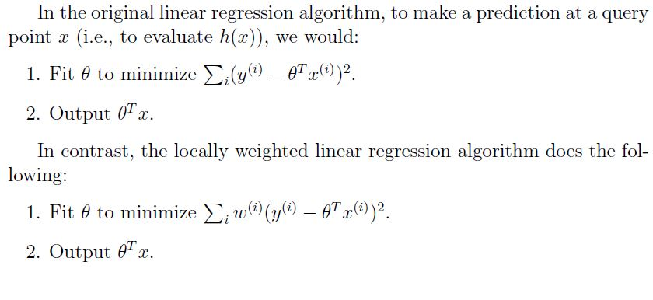
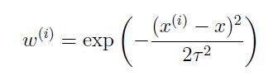
Notes:
The T is the bandwidth parameter, which defines the range over which generalization is performed.

Slide 25
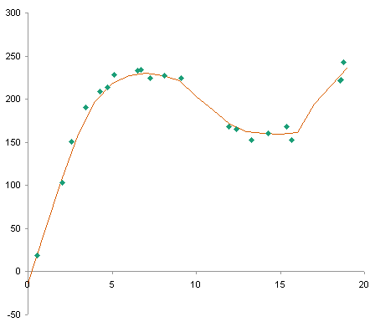
Example for LWR

Slide 26
Logistic regression
Used for estimation of the parameters of a qualitative response model.
Uses probability scores as the predicted values of the dependent variable.
Binary logistic regression:
Multinomial logistic regression:
Notes:
In the previous regression models we were assuming that the output variable takes numerical values. However sometimes the dependent variable does not have numerical values and it has qualitative values. Logistic regression is used in these types of situations. It is used for estimation of the parameters of a qualitative response model and it used probability scores as the predicted values of the dependent variable.
There are two types.
There is binary logistic regression in which the dependent variable can have only two possible values like yes or no, 0 and 1. We are going to concentrate on this type.
There is also the multinomial logistic regression in which, the dependent variable can have three or more values. Like the different types of the Iris flower in the iris data set.

Slide 27
Binary Logistic regression
Binary output variable Y, conditional probability Pr(Y = 1|X = x) as a function of x.
1 - Most obvious idea: let p(x) be a linear function of x.
problem: p must be between 0 and 1, and linear functions are unbounded.
2- Next idea: let log p(x) be a linear function of x
Problem:
logarithms are unbounded in only one direction, and linear functions are not.
Notes:
Here is the binary logistic regression problem. The binary output dependent variable is Y, we want to calculate the conditional probability function of Y being 1 as a function of x. (p(x)
The first idea would be to estimated p(x) as a linear function of x. However, since p(x) is a probability function, the value ranges between 0 and 1, but linear functions are unbounded.
The second idea would be to estimated log p(x) as a linear function of x. However, while logarithms are bounded in one direction they are unbounded in the other directions.
So this would not be good estimation either.

Slide 28
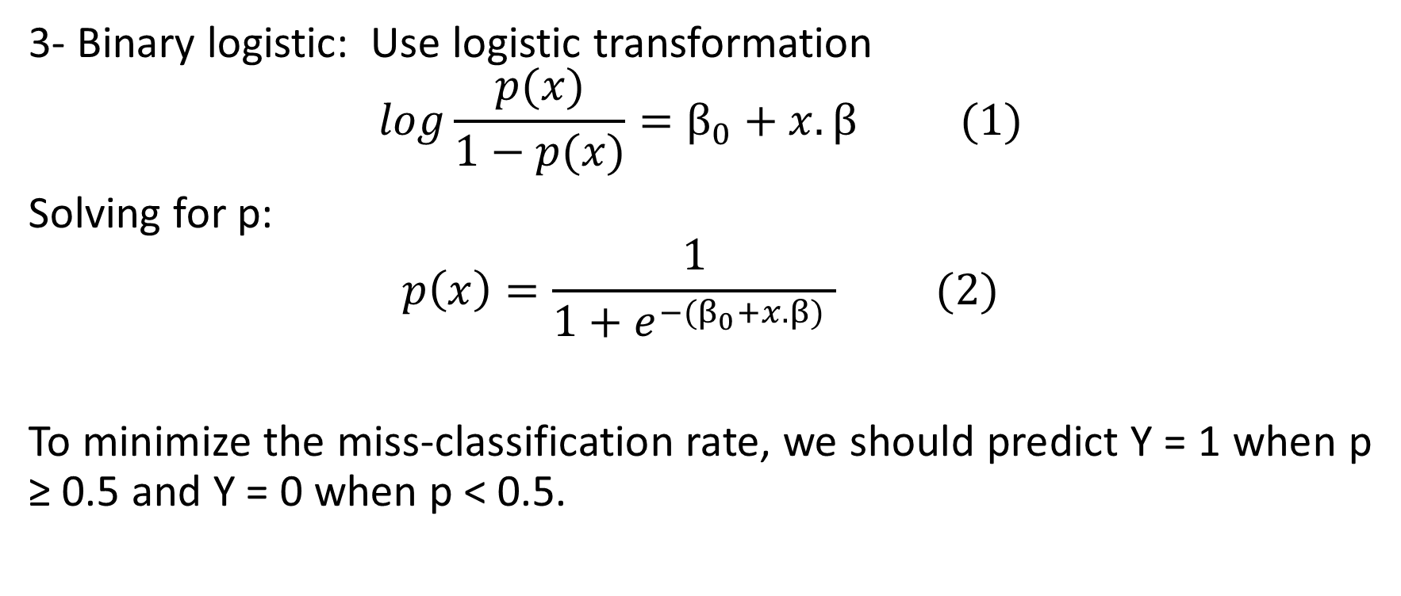
Binary Logistic regression
3- Binary logistic: Use logistic transformation
$$log\frac{p(x)}{1−p(x)}=β_{0}+x.β (1)$$
Solving for p:
$$p\left(x\right)=\frac{1}{{1+e}^{−(β_{0}+x.β)} } (2)$$
To minimize the miss-classification rate, we should predict Y = 1 when p ≥ 0.5 and Y = 0 when p < 0.5.
Notes:
The other idea is to estimated the logistic transformation of the p(x) as a linear function of x as illustrated in (1). If we solve for p we get the 2nd equation. We can see that for any value of x the value of p(x) would be between 0 and1. While this model will have errors it is better that last two previous solutions. As we said the output variable is binary thus if p(x) is above 0.5 we predict a Y=1 and if its lower we predict a Y=0.

Slide 29
Simple Example
X: Gestational age of the infant in weeks at the time of birth
Y: Whether the infant was breast feeding at the time of release from hospital
For each level of X, the weighting factor is the number of observations for that level.
X | Instances of Y Coded as |  | Total | Y as observed probability | Y as Odds (p/(1-p)) | Y as log Odds
 | 0 | 1
28 | 4 | 2 | 6 | 0.33 | 0.5 | -0.69
29 | 3 | 2 | 5 | 0.40 | 0.67 | -0.40
30 | 2 | 7 | 9 | 0.78 | 3.5 | 1.25
21 | 2 | 7 | 9 | 0.78 | 3.5 | 1.25
32 | 4 | 16 | 20 | 0.80 | 4 | 1.38
33 | 1 | 14 | 15 | 0.93 | 14 | 2.64
http://vassarstats.net/logreg1.html
Notes:
We will show a simple example. A study that was done 24 infants. X, the first column is the Gestational age of the infant in weeks at the time of birth. Y is Whether the infant was breast feeding at the time of release from hospital, 0 shows no and 1 shows yes. Total shows the total number of observations for a certain gestational age. Next column shows Y as observed probability. For the case of 28 weeks of gestation age, the infants were breastfeeding out of 6 so the probability is 1/3. The next column shows p/(1-p) and the next column shows the logistic transformation of p(x).
Now we want to do regression analysis to calculate p(x) as a function of x (gestational age)

Slide 30
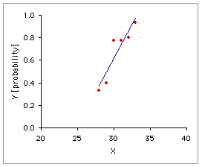
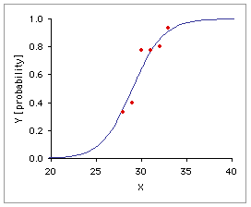
Example
Linear
Logistic
Notes:
Here are the results for linear and logistic regression analysis. The problem with linear regression is obvious here. If X is increase beyond a certain level Y probability will go over 1 and if X is decreased beyond a certain point it will be negative, which is unacceptable results for the a probability function. But for the logistic regression is always between 0 and 1. Moreover as the slope of the linear function increases the transition from 0 to 1 will be faster.

Slide 31
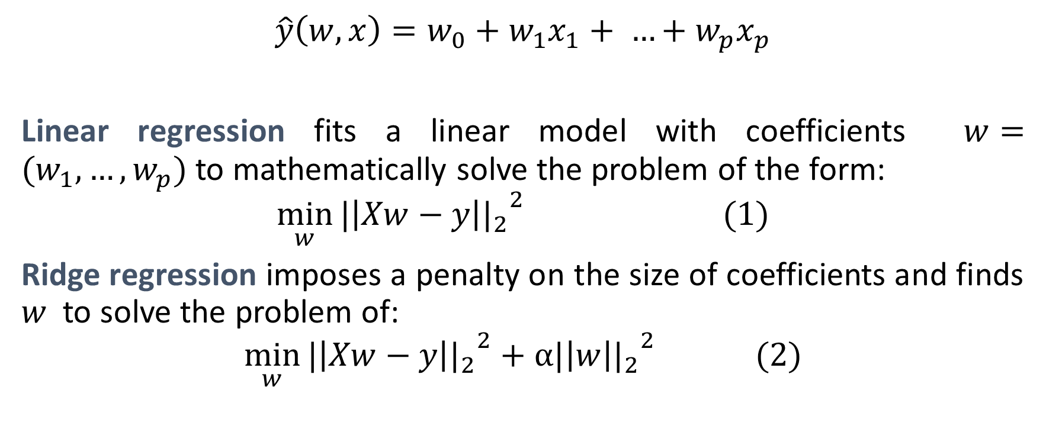
Ridge Regression
$$\hat{y}\left(w,x\right)=w_{0}+w_{1}x_{1}+ …+w_{p}x_{p}$$
Linear regression fits a linear model with coefficients $w=(w_{1},…,w_{p})$to mathematically solve the problem of the form:
$$\min_{w}{{{|\left|Xw−y\right||}_{2}}^{2} (1)}$$
Ridge regression imposes a penalty on the size of coefficients and finds $w$ to solve the problem of:
$$\min_{w}{{{|\left|Xw−y\right||}_{2}}^{2}+α{{|\left|w\right||}_{2}}^{2} (2)}$$
Notes:
Kalhan talked about linear regression. Linear regression calculated the weights in order to minimize the offset of the error using equation 1. However, we also want to reduce the variance of the error. In order to do that we will have to reduce the size of the weights. That what Ridge regression does. Ridge regression imposes a penalty on the size of coefficients and find w to minimize the second equation.
If the value of a is 0 it will the same as the linear regression but as the value of a increases, the sized of the weights will have to be reduced. We will refer to the weight coefficients for ridge regression as ridge coefficients.

Slide 32
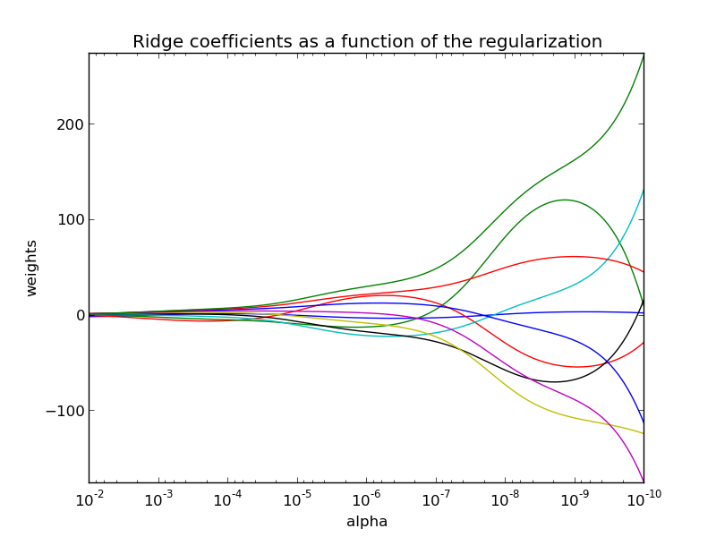
Ridge Regression
α≥0 is a complexity parameter that controls the amount of shrinkage
http://sccikit-learn.org/stable/auto_examples/linear_model/plot_ridge_path.html
Notes:
Here you can see the Ridge coefficients as a function of a. Each color shows the results for one Ridge coefficient.
As we move to right the value of a decrease and we go toward linear regression. We can see that the size of the weights increases. As we go toward left, alpha is increasing and the Ridge coefficient are decreasing. Thus they will result in lower variance of errors.

Slide 33
Lasso of Regression
Lasso regression
A linear model that estimates sparse coefficients.
Solutions with fewer parameter values, effectively reducing the number of variables upon which the given solution is dependent.
Notes:
Sometimes the output variable is dependent on many parameters and we may want to limit our analysis on only the most influential ones. That when we use lasso regression.
A linear model that estimates sparse coefficients. It uses an iterative approach to eliminate less important parameters and effectively reduces the number of variable upon which, the given solution is dependents.

Slide 34
Applications
Applications

Slide 35

Relation between Smoking and Lung Cancer
In 1950 Sir Richard Doll ,an epidemiologists along with his partner Sir Bradford Hill found out smoking causes lung cancer.
Survival from age of 35 for smokers ,non-smokers and people who quit smoking was taken by him.
Linear line for all helped him to derive that Smoking increases the chances of lung cancer.
Notes:
Regression analysis was used to find out relationship between smoking and lung cancer. In 1950, Sir Richard Doll and Sir Bradford Hill found out smoking causes Lung Cancer.
Survival from the age of 35 for smokers, non smokers and people who have quit smoking was recorded by them. Linear line helped them that smoking increases the chance of lung cancer.
Slope of smokers > slope of people who have quit smoking > slope of non smokers.

Slide 36
Applications of Linear Regression
Evaluating Trends and Sales Estimates
If a company's sales have increased steadily every month for the past few years
linear analysis on the sales data with monthly sales on the y-axis and time on the x-axis
After creating the trend line, the company could use the slope of the line to forecast sales in future months
Notes:
Linear Regression is used to estimate sales of company. When sales of company increases steadily every month for past few years. To estimate the future sale company perform linear analysis on the sales of data with the monthly sales on Y-Axis and time on X-Axis. After getting a trend line they use slope to forecast sales in future months.

Slide 37
Analyzing the Impact of Price Changes
If a company changes the price on a certain product several times
It can record the quantity it sells for each price level and then perform a linear regression
The result would be a line that depicts the extent to which consumers reduce their consumption of the product as prices increase
Any other real world example that you can think of?
Notes:
To analyze the impact of price changes when a company changes the price of a certain product several times and record the quantity of product sold for each price level. They could perform a linear regression and the result would be a line that depicts the extent to which consumer reduce their consumption as price increase. This will help the company to determine whether the price rise is hampering their profit.
Any other real world example that you can think of?
Answer : Health Insurance Company perform analysis of Customer Vs age and realize that older customer claim for health insurance more.

Slide 38
Application of LWL
Electric Load Forecasting
Load forecasting is essential for efficient system planning and operation.
The relationship between electric load and its exogenous factors are complex.
LWR forms a local model around a point of interest.
After answering the query, the model is discarded and a new model is created for a new query.
Notes:
LOAD forecasting has always been the essential part of an efficient power system planning and operation. It is always defined as basically the science or art of predicting the future. The relationship between electric load and its exogenous factors is complex and nonlinear, making it quite difficult to be modeled through traditional techniques such as linear or multiple regression. LWR forms a local model around a point of interest whereby only training data that are closest to that point will be used in handling each query, instead of using all training data . After answering the query, the local model is discarded. To answer a new query, a new local model is created, which means that every set of training and generation period is unique and independent of others.

Slide 39
Autonomous helicopter flight
On going research by Andrew Y Ng. in Stanford.
A human pilot to fly the helicopter for several minutes
12-dimensional helicopter state and 4 dimensional helicopter control inputs
In autonomous mode , in response to a query, LWL regression makes the prediction .
Notes:
There is an on going research in Stanford University by Andrew Y Ng. in Stanford University For training purpose a human pilot flies the helicopter for several minutes. The input is stored in 12-dimensional helicopter state and controls are stored in 4 dimensional state. 339 seconds of flight data

Slide 40
Case Study : Betting System
In 2012, the online sports betting industry was projected to be worth $13.9 billion
Approximately $7 billion wagered on soccer alone
Sky bet, Bet365, BetVictor , Betfred, 10Bet
Bookmakers take advantage of human preference for risk
Irrational team loyalty of fans in the face of poor odds.
A betting company prefer to minimize risk for themselves.
Home Draw Away
2.2 3.2 3.5
Any method used to determine the optimal size of a series of bets?
Notes:
In 2012, the online sports betting industry was projected to be worth $13.9 billion industry and approximately $7 billion wagered on soccer alone. Some of the most popular betting companies are Sky bet, Bet 365, BetVictor,10Bet. These betting companies take advantage of human preference for risk an the irrational team loyalty of fans in the face of poor odds. However, a betting company prefer to minimize risk for himself as much as he can.
Kelly criterion is used to decide optimal size of a series bets.

Slide 41
Datasets Used in a PL Soccer Betting System
Frequency counts of in game events from the PL season, such as tackles, shots, yellow cards, and more, recorded for each player individually.
whole team, including overall performance in previous matches.
The capacity of the team's stadium, from the Premier League Handbook.
The location of the team's stadium.
team's performance in the previous season
total amount paid in player wages in the previous season
The total cost value of the team's squad.
manager's performance
Notes:
Premier league Soccer Betting System uses following datasets to predict the outcome of a match.
Frequency counts of in game events from the PL season, such as tackles, shots, yellow cards, and more, recorded for each player individually.
whole team, including overall performance in previous matches.
The capacity of the team's stadium, from the Premier League Handbook.
The location of the team's stadium.
team's performance in the previous season
total amount paid in player wages in the previous season
The total cost value of the team's squad.
manager's performance

Slide 42
Dataset used for our case study: Opta
Manchester City Football Club in cooperation with OPTA made an extensive dataset for the 2011-2012 EPL season publicly available
unique opportunity to explore this resource with the use of suitable techniques to gain insight into the evaluation of player and team performances
Notes:
For the First time, In the history of Soccer Manchester City Football Club in cooperation with OPTA made an extensive dataset for the 2011-2012 EPL season publicly available.
There have been dataset available and analysis taken place for other sports like base ball. Because of this publicly available dataset, everyone got unique opportunity to explore this resource with the use of suitable techniques to gain insight into the evaluation of player and team performances.

Slide 43
210 attributes and 10369 instances
we break our dataset in four parts:
an attackers dataset
a defenders dataset
a midfielders dataset
a goalkeepers dataset
Combination of all the above helps to rate the entire team
Probabilistic Models are then used to set the odds by the Bettors
Attributes most relevant and Target class of each dataset?
Notes:
The dataset contains 210 attributes and 10369 instances. For convinience we are breaking our dataset into four parts:
1.an attackers dataset
2.a defenders dataset
3.a midfielders dataset
4.a goalkeepers dataset
So What could be the Attributes most relevant and Target class of each dataset?
Answer : Attributes: Shots on Target , penalties taken, Target Class: goals for attacker dataset.
Attributes: Clearances, Successful tackles , Target Class: shots blocked for defenders.
Attributes:Successful Croses, through balls, Target Class: Assist for Mid-Fileders
Attributes: Saves Made, catches, punches, Target Class : Clean sheet.

Slide 44
Systems Used
Weka(Waikato Environment for Knowledge Analysis)
contains a collection of visualization tools and algorithms for data analysis and predictive modeling
Excel
Microsoft Excel is a spreadsheet application developed by Microsoft. It features calculation, graphing tools, pivot tables, and a macro programming language
R
R is an integrated suite of software facilities for data manipulation, calculation and graphical display. It includes a large, coherent, integrated collection of intermediate tools for data analysis
Notes:
We are using the below systems for our demonstration and attackers dataset.
Weka will be used to find relevant attributes from 208 attributes for the attacker dataset.
Microsoft Excel will be used to find the trend line
R and also Weka will be used to run Linear and LWL regression

Slide 45
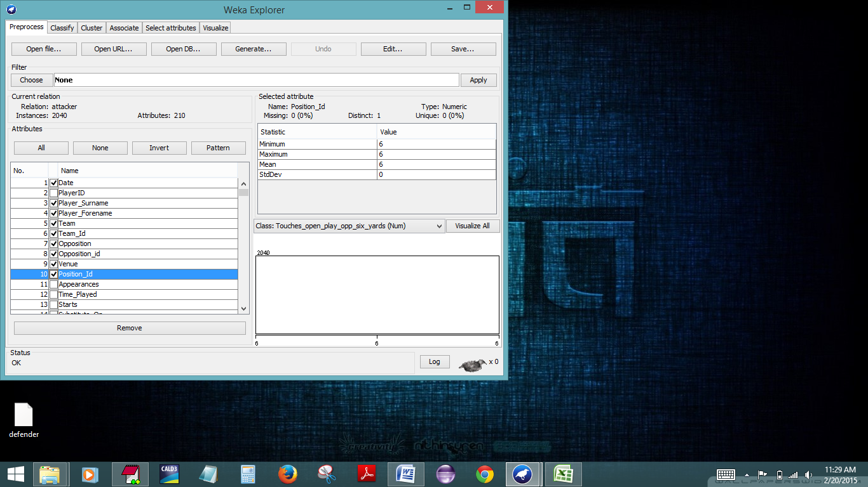
Analysis with Weka :
Notes:
Load attacker dataset into Weka.
Remove all the numeric attributes such as team id, position id etc.

Slide 46
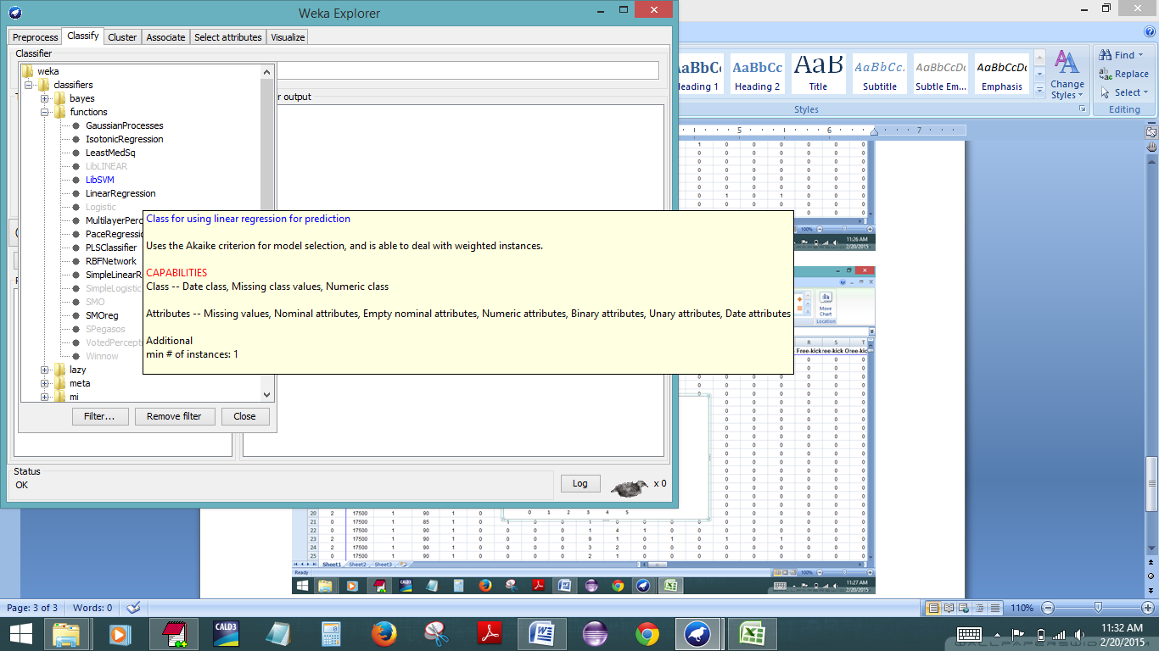
Notes:
1.Go To Classifiers
2.Choose functions and
3. Run Linear Regression.

Slide 47
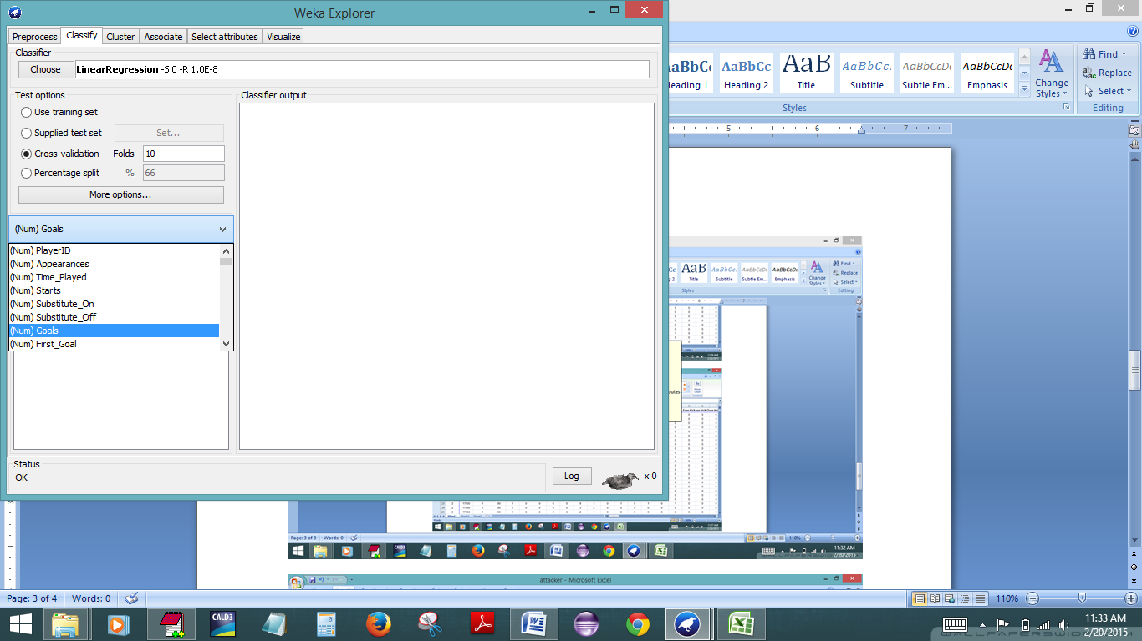
Notes:
Select Goal as the target class.

Slide 48
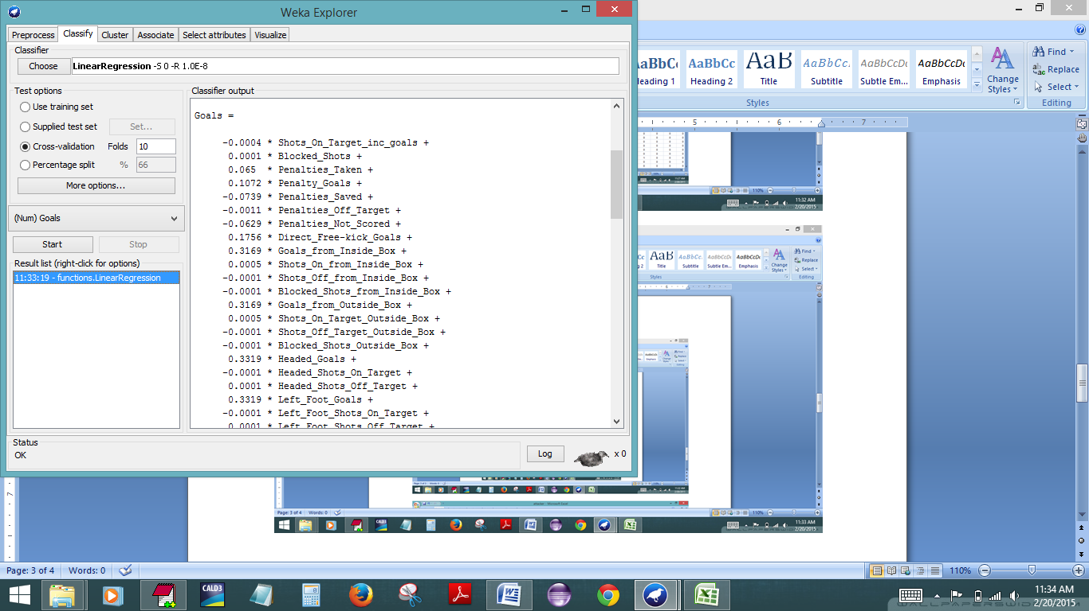
Notes:
Click on Start to run the algorithm.

Slide 49
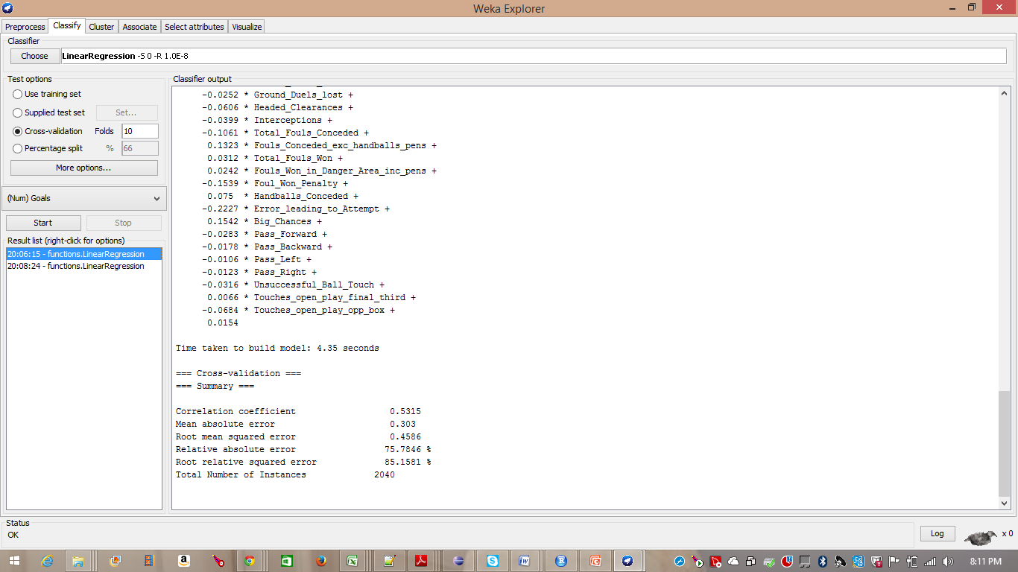
Notes:
The Correlation Coefficient is : 0.5315
Keep only positive attributes as negatives and zeroes don’t contribute much to build the model.

Slide 50
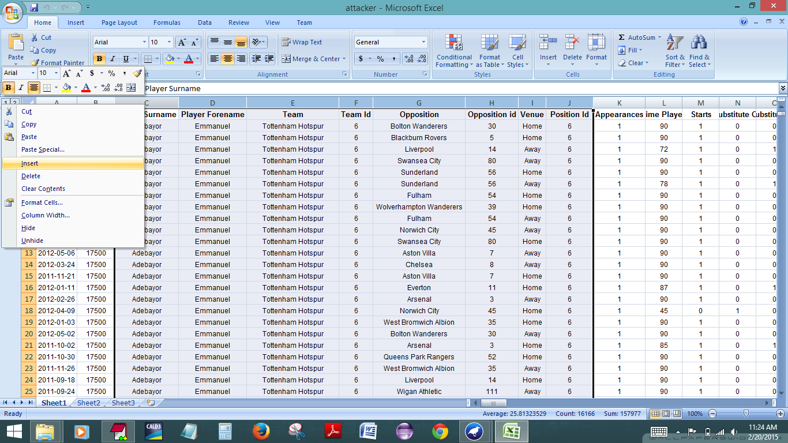
Trend Line Through Excel :

Slide 52
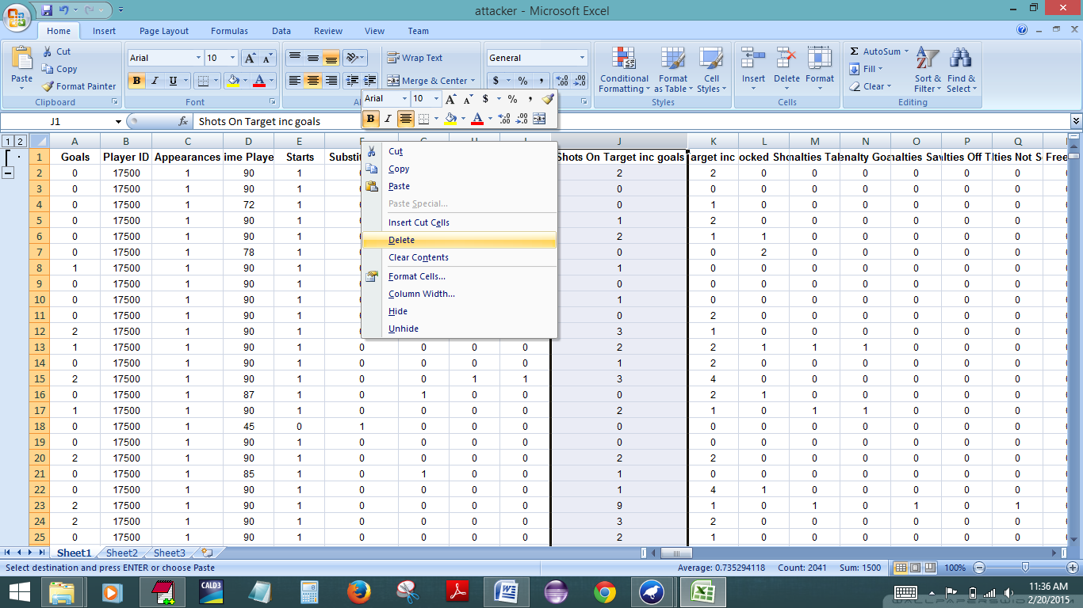

Slide 53
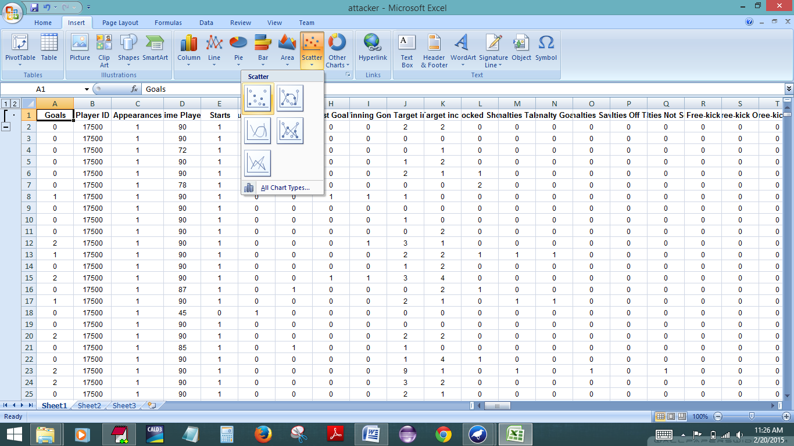

Slide 54
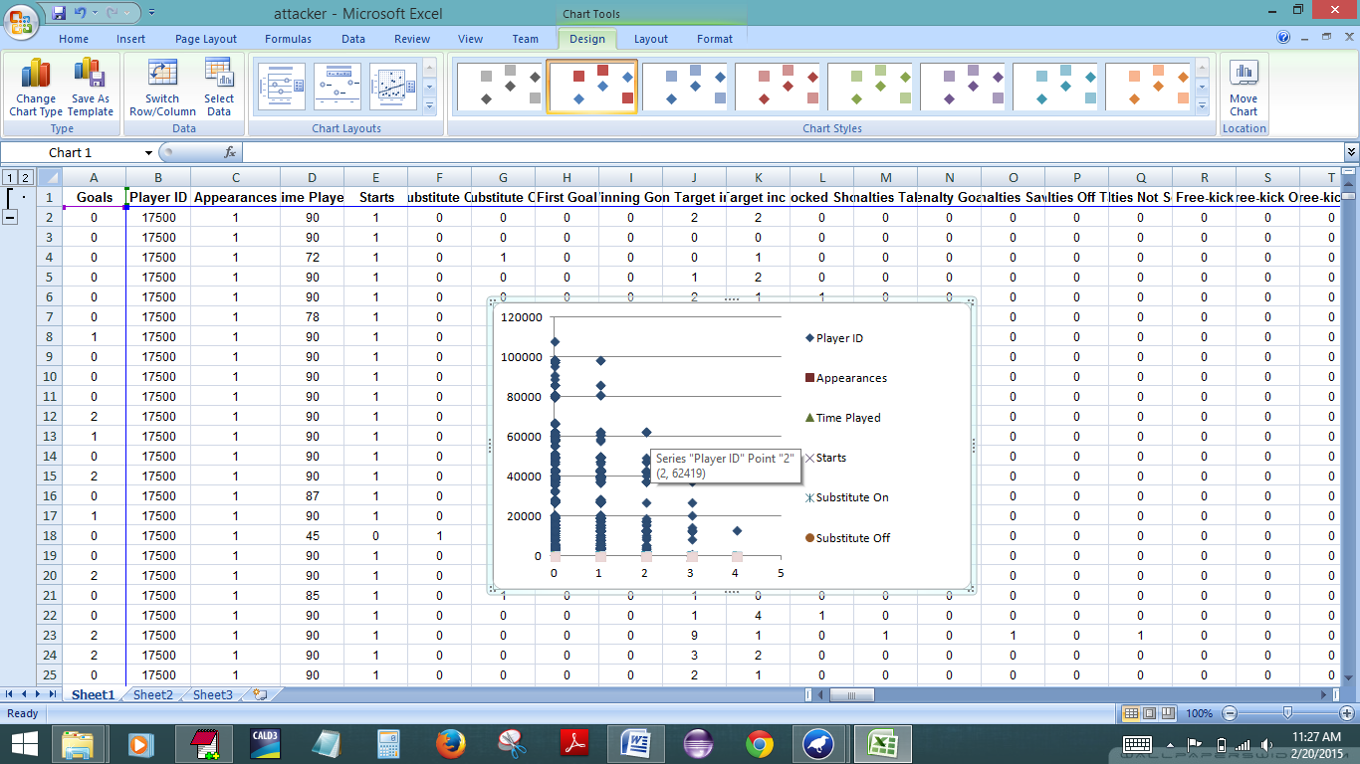

Slide 55
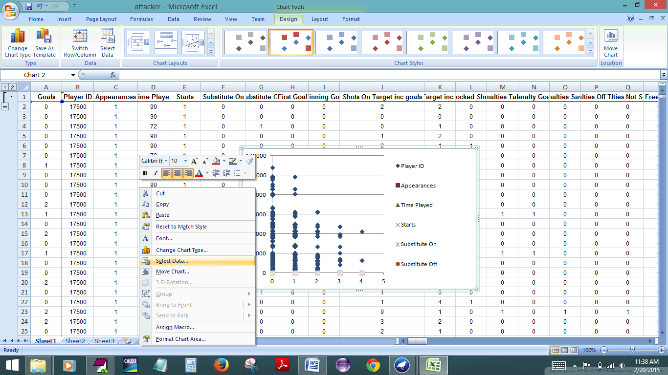

Slide 56
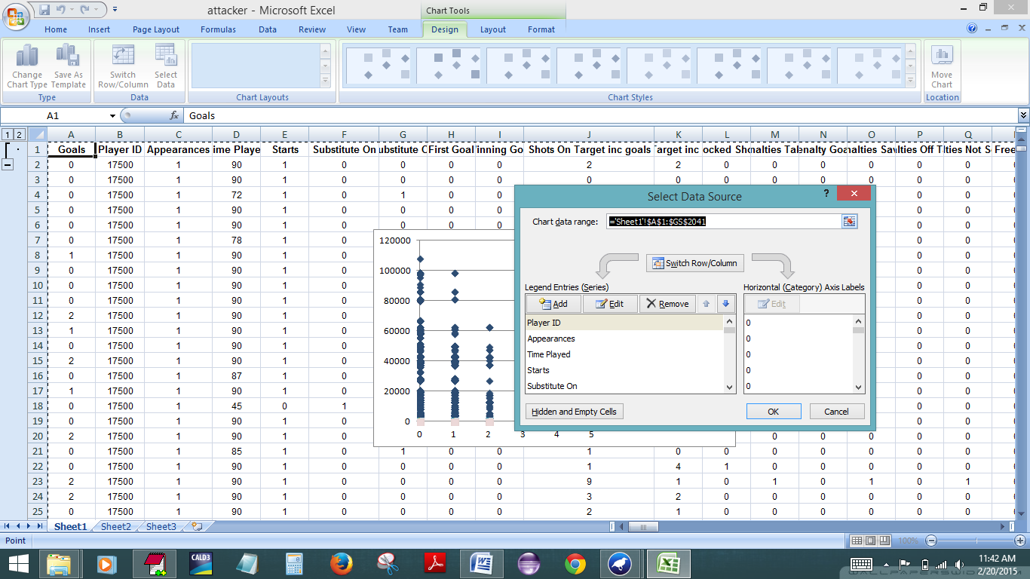

Slide 57
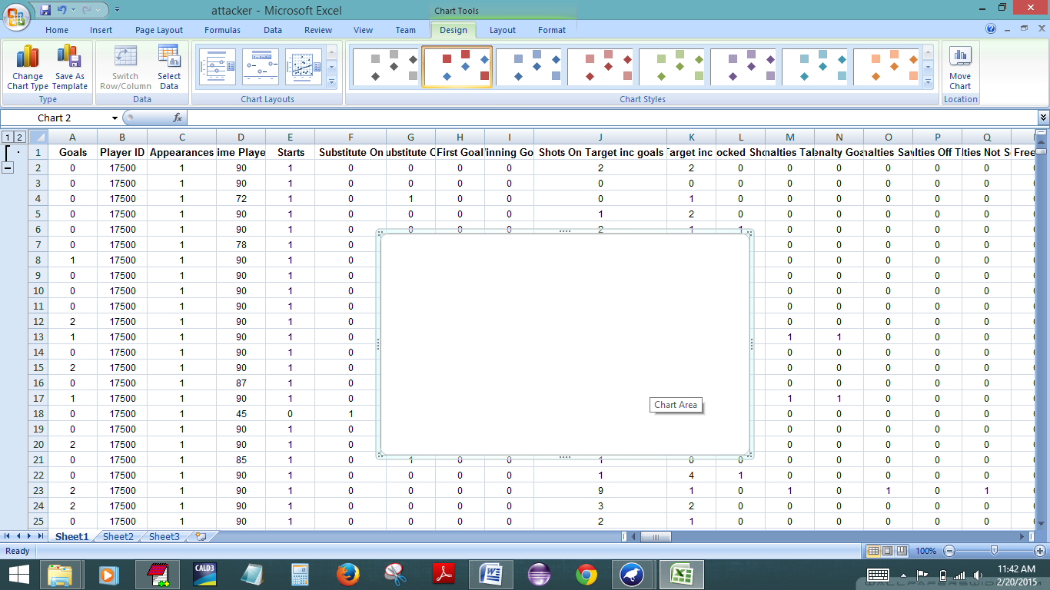

Slide 58
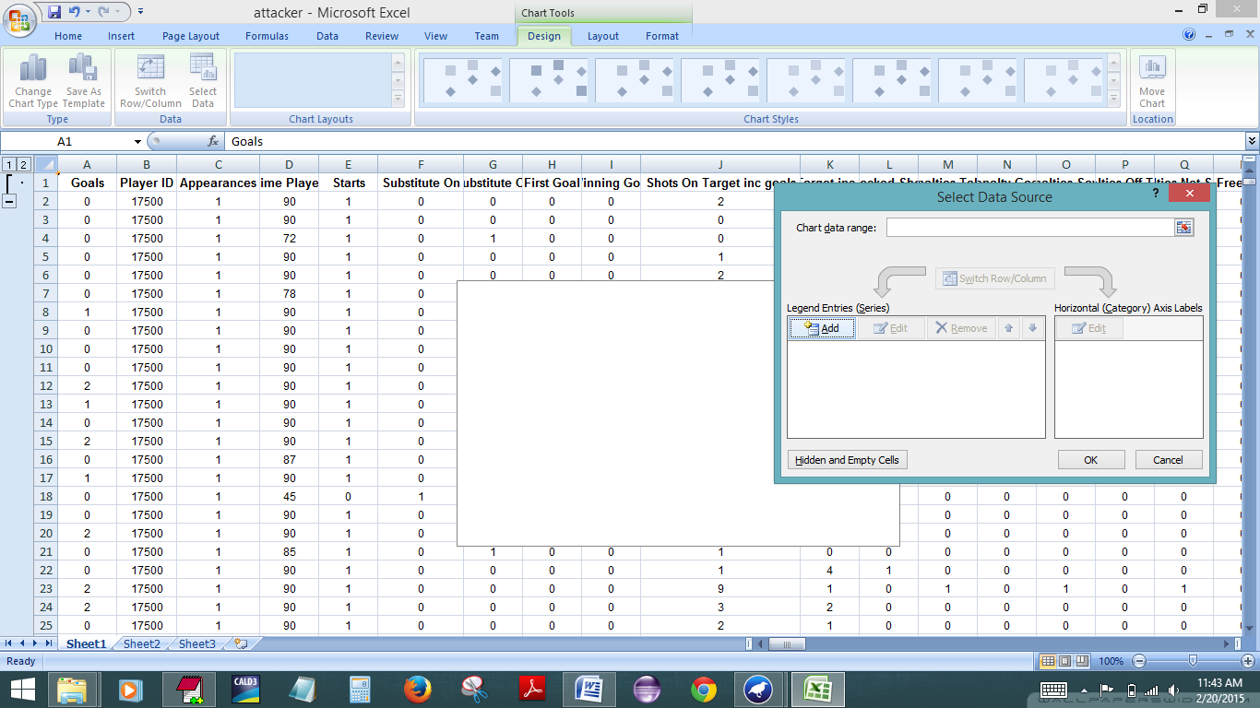

Slide 59
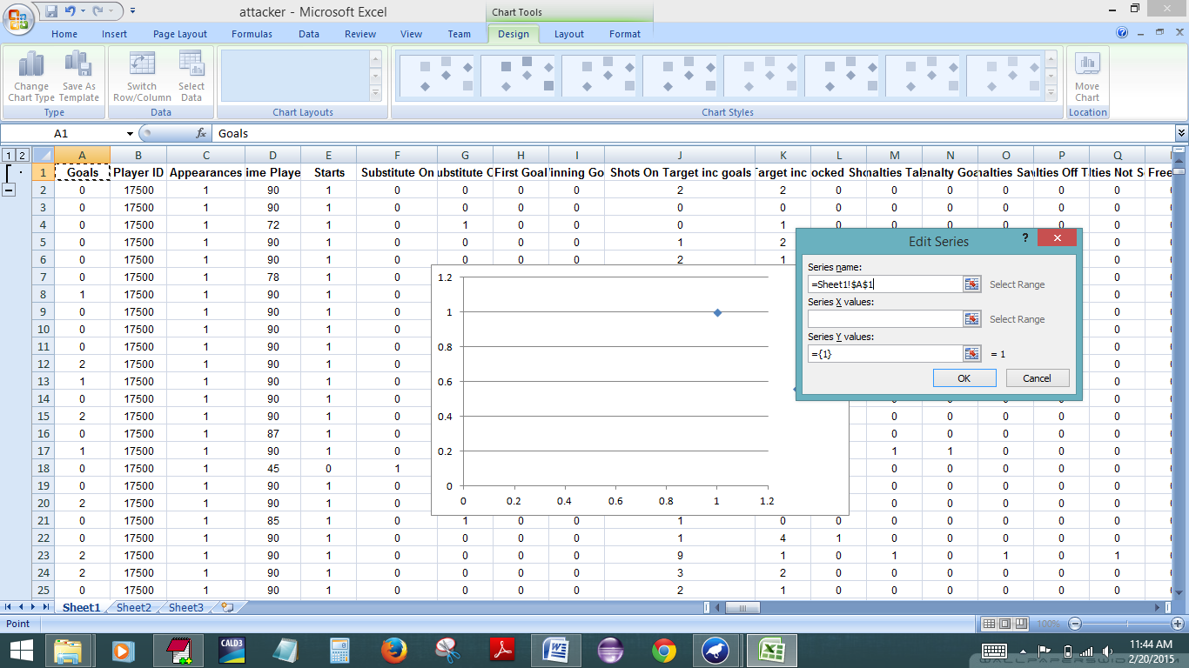

Slide 60
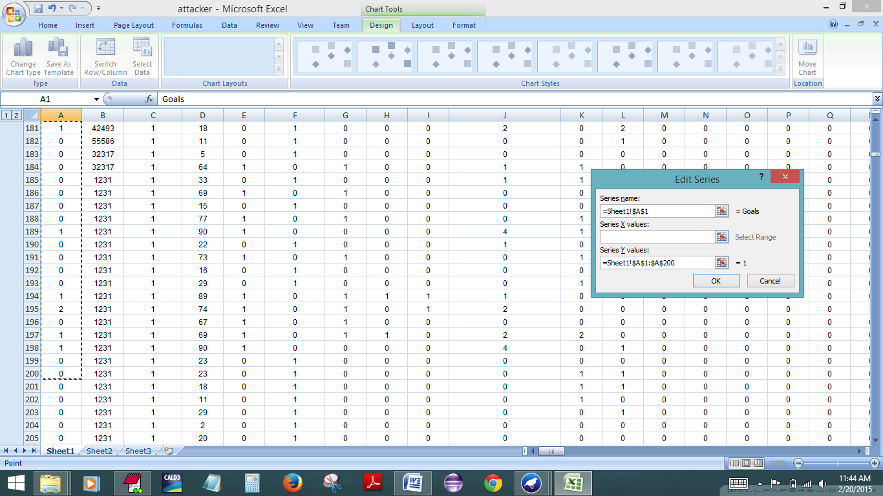

Slide 61
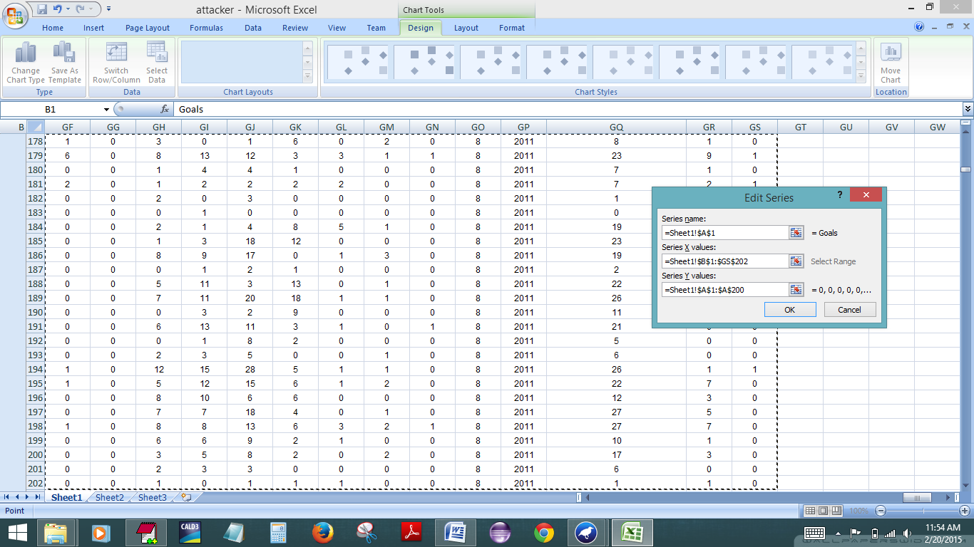

Slide 62


Slide 63


Slide 64


Slide 65


Slide 66


Slide 67

Installing R and R-Studio
Notes:
Go to www.r-project.org to install R
Click on CRAN (Comprehensive R archive network).

Slide 68

Notes:
1.Select area that is most nearest to you. (National Cancer Institute, Bethesda, MD, USA in our case)

Slide 69

Notes:
1. Download R for your respective Operating System. (Windows in my case).

Slide 70


Slide 71

Notes:
Click on Next button.

Slide 72

Notes:
Choose the location in your system where you want to install R.

Slide 73

Notes:
Go to www.rstudio.com
Rstudio is an IDE for R.
Click on Downlaod R studio.

Slide 74

Notes:
1. Click on Download Rstudio Desktop

Slide 75

Notes:
Choose Rstudio for your respective.

Slide 76

Notes:
A set up installation will start. Click Next.

Slide 77

Notes:
Set the location for installation.

Slide 78
Script for R-analysis
#Load the attacker_analysis.csv
attacker_data <- read.table(file.choose(),header=T,sep=',')
#attach the data
attach(attacker_data)
#Performing linear regression on our data
model_linear<-lm(Goals~First.Goal+Winning.Goal+Shots.Off.Target.inc.woodwork+Blocked.Shots+Penalties.Taken+…)
summary(model_linear)
#calculate coefficients
coefficients(model_linear)
#check the regression diagnositics plots for this model
plot(model_linear);
Notes:
Read.table will bring up a pop up window to choose the dataset file which can be in a .csv or .txt format.
Attach will attache the file into the attacker_data object.
LM will perform linear regression where goals are the target class and remaining are the attributes and will save the result in model_linear object.
Summary(model_linear) will display summary of the analysis.
Coefficients(model_linear) will calculate the coefficients of the analysis.
Plot(model_linear) will give a visualized output of the analysis.

Slide 79

Analysis with R :
Notes:
1.Load this script in script window and click run button or write this script in console.

Slide 80


Slide 81

Notes:
Coefficients of each attribute

Slide 82


Slide 83


Slide 84

Notes:
Perform Linear regression again through weka but this time with the reduced attacker dataset of 47 attributes.
Correlation coefficient is 100%.

Slide 85

Notes:
The correlation coefficient is 87.17% for LWL.

Slide 86
Results :
Linear Regression:
Correlation coefficient 1
Mean absolute error 0.0001
Root mean squared error 0.0037
LWL:
Correlation coefficient 0.8717
Mean absolute error 0.1006
Root mean squared error 0.2677

Slide 87
Equation : y = -0.0003x +0.4326
R-square : 0.0006
Multiple R-squared: 1
F-statistic: 1.244e+30 on 33 and 214 DF, p-value: < 2.2e-16
Residual standard error: 1.633e-15 on 214 degrees of freedom
(Intercept) :4.429e-16
Exercise:
Similar analysis on Defenders, Midfielders, Goalkeepers datasets
Defender Analysis : https://drive.google.com/file/d/0B43LYaAI4zp6Z2hoWkYyX3RnZGM/view?usp=sharing
Goal Keeper Analysis : https://drive.google.com/file/d/0B43LYaAI4zp6ZVZtcHVOQlRkU2s/view?usp=sharing
Mid fielder Analysis : https://drive.google.com/file/d/0B43LYaAI4zp6WnRsMHR6WlBZelk/view?usp=sharing
Attacker Analysis: https://drive.google.com/file/d/0B43LYaAI4zp6aHJBS3FvZHRqRDQ/view?usp=sharing

Slide 88
Conclusion:
Regression is used to find the trend of output changes with respect to input features.
Different types maybe better for estimation of different datasets.
LWL found to be more correlated in our case study compared to Linear regression.

Slide 89
References :
References for Linear Regression and Locally Weighted Regression:
Most of the images and equations are from: https://www.youtube.com/watch?v=5u4G23_OohI
https://www.youtube.com/watch?v=HZ4cvaztQEs
Some references which are used for small concepts :
http://vilkeliskis.com/blog/2013/09/08/machine_learning_part_2_locally_weighted_linear_regression.html
http://scikit-learn.org/dev/auto_examples/model_selection/plot_underfitting_overfitting.html

Slide 90
References :
Dataset for the premier league : http://www.optasportspro.com/en/about/optapro-blog/posts/2012/mcfc-analytics-a response.aspx
Papers for Betting System :
1. Machine Learning for Soccer Analytics by Gunjan Kumar
2: What Actually Wins Soccer Matches: Prediction of the 2011-2012 Premier League for Fun and Profit by Jerey Alan Logan Snyder
Learning R Statistical Analysis :
1.http://www.statmethods.net/advstats/index.html (Quick-R) 2.Practical Data Science with R by Nina Zumel and John Mount
Papers for LWL AppliCations:
1.Electric Load Forecasting Based on Locally Weighted Support Vector Regression by Ehab E. Elattar
2. Autonomous helicopter flight via Reinforcement Learning by Andrew Y. Ng, H. Jin Kim, Michael I. Jordan, and Shankar Sastry
3.Locally-weighted Homographies for Calibration of Imaging Systems by Pradeep Ranganathan and Edwin Olson

